Slide 1



Generational Shift in US Collectibles Search Intent
Gen Z vs. Millenials/GenX Cohorts

Slide 2
Gen Z collectors consolidate heavily
around display-first brands.
Share of Search Ranking — Gen Z
Labubu
36.7%
Funko Pop!
35.4%
Jelly Cat
6.1%
Labubu and Funko Pop! capture a combined 72% search share among Gen Z.
Squishmallow
5.3%
Pop Mart
5.0%
Gen Z concentrates on one or two dominant, display-focused objects.
Lorcana
4.6%
Smiski
3.3%
Older cohorts have broader interests, with top brands holding only 53.5% share.
Stanley Cups
1.6%
Be@rbrick
1.2%
Sonny Angel
0.9%

Slide 3
Iconic Brands Still Win with Millennial & Gen X Collectors
Gen X/Millennial Native Search Share
Hot Wheels
28.2%
Magic: the Gathering
25.3%
More diversified demand than Gen Z
Interest spread across a broader range of collectibles.
Established brands dominate
Hot Wheels, Magic: The Gathering and Pokémon lead, underscoring the power of long-term brand equity.
Nostalgia drives discovery
Strong interest in vintage and retro collectibles such as vinyl records, Tamagotchi and vintage digital cameras.
Pokémon
21.3%
LEGO Collectibles
12.9%
Vinyl Records
8.9%
Tamagotchi
1.7%
Vintage Digital Camera
1.6 %

Slide 4
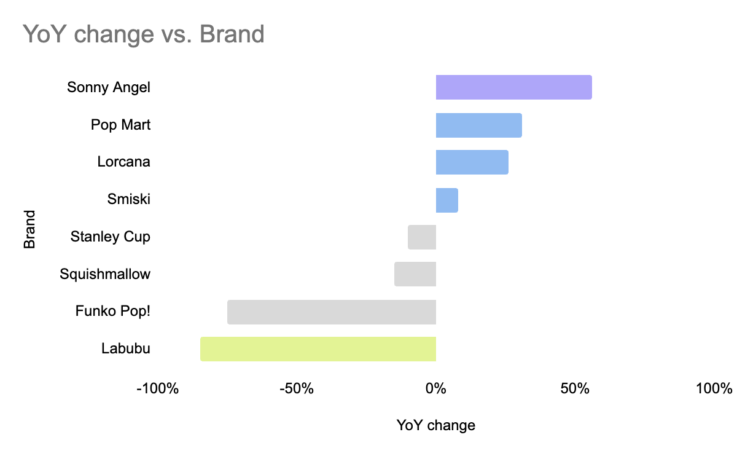
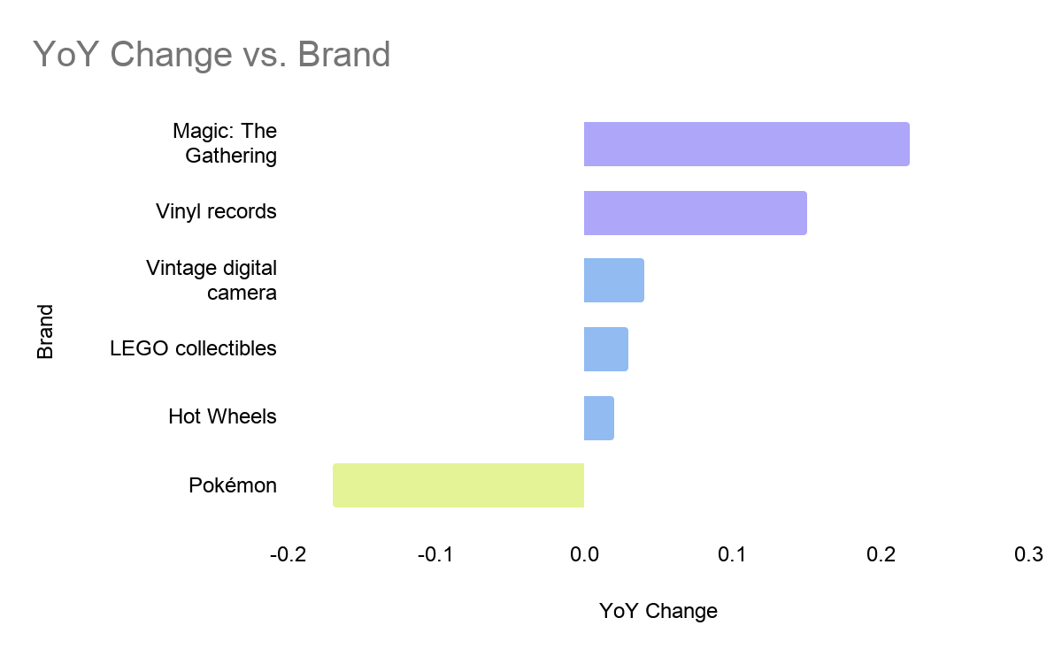
Gen Z Trends are Highly Volatile
Compared to Stable Legacy Brands
YoY Performance: GenZ vs. GenX and Millennials Brands
Gen Z Search Interest
Rapidly rotating cycles with sharp year-over-year declines.
Gen X and Millennial Search Interest
Established brands maintain resilient, positive growth paths.
Rapid Gen Z Cycles
Gen Z cycles rotate rapidly: Labubu fell 85% and Funko Pop! dropped 75% year-over-year.
Stable Legacy Brands
Legacy brands (Magic: The Gathering, Hot Wheels) maintained stable growth between +2% and +22% year-over-year.

Slide 5

Seasonality and
Peak Intent
Search Intent vs. Monthly Average (%)
August
+ 27%
Back to School Peak
August–September is the strongest stretch, with collectibles search up 27% and 22% vs. average.
December
+ 25%
September
+ 22%
July
+ 15%
Holiday Surge
December creates a second, distinct peak with search activity up 25%
January
+ 12%
October
+ 3%
February
- 4 %
November
- 5 %
Summer Lows & Flat Events
June is the annual low (-32%). Traditional retail events like Black Friday, Cyber Monday, and Valentine's Day show no lift.
April
- 6%
March
- 16%
May
- 17%
June
- 32%
0%
50%
100%
150%

